Slide 1
Structural and Mechanical Properties of Polyelectrolyte Brushes
Takashi Yokokura
Advisor: Prof. Rui Wang
September 14th, 10:00 am – 12:00 pm
Qualifying Exam

Slide 2



Introduction
Polymer Brush
Chains end-fixed to some substrate
Steric interactions extend chains into solution
+
+
+
+
+
+
+
+
+
+
+
+
+
+
+
+
+
+
+
+
+
+
+
+
+
+
+
+
+
+
+
+
+
+
+
Polyelectrolyte Brush
Monomers contain charge
Long-range electrostatic interactions drive extension
+
+
+
+
+
+
+
+
+
+
+
+
+
+
+
+
+
+
+
+
+
+
+
+
+
+
+
+
+
+
+
+
+
+
+
+
Conformational possibilities
Coexistence between dilute, coil-like layer and condensed layer
+
Designable functionalized surface
Anti-fouling
“Smart” sensors
Cell-repellant Surface
Model system for biological aggregates
Axon stabilization through neurofilaments
(Chen, et al., Macromolecules, 2017 )
(Yuan, et. al., J. Cell Sci., 2012)

Slide 3





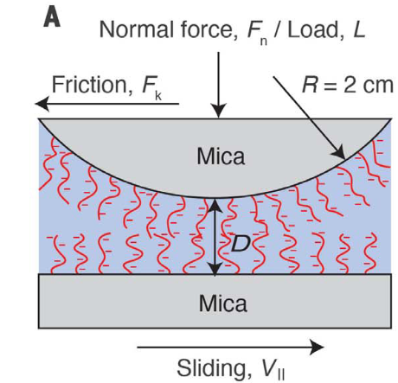
Previous Theories
Flory scaling – de Gennes, Alexander
Lattice-constrained Scheutjens-Fleer SCFT
Correlation length:
No. monomers in correlation blob:
Brush height:
(Rubinstein, Colby, Oxford Univ. Press, 2003)
Kuhn monomer length
Scaling exponent, 0.588
1 mM Ba²⁺
Drawbacks:
Elasticity is inaccurately considered
Effects from multivalent ions cannot be captured
1 mM Ca²⁺
0.1 mM Ca²⁺
0.01 mM Ca²⁺
6 mM Na⁺
(Yu et al., Science, 2018)

Slide 4





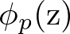



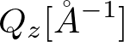
Presentation Overview
Theory
Systematic Study
Repulsive
Attractive
Application to Experiments
Brush Response to Ionic Strength

Slide 5
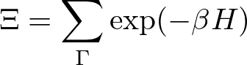
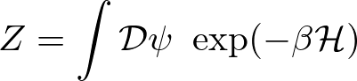




Outline
Model and Theory Development
111
111
Particle description
Field description
Self-consistent field theory

Slide 6
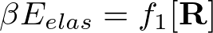

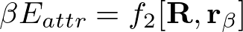


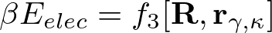



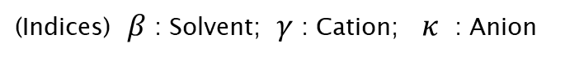
System Species and Interactions
What is the system made up of?
s
+
-
Interactions:
Elasticity (monomer-monomer)
Solubility (solvent-monomer)
Electrostatics (ion-monomer)
Polymer curve
+
-
s
+
s
s
s
-
+
+
+
+
+
+
+
-
+
s
Discrete particle locations
+
s
+
-
s
+
-
s
s
+
+
s
(Indices) $β$ : Solvent; $γ$ : Cation; $κ$ : Anion

Slide 7


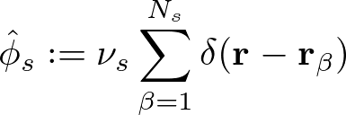






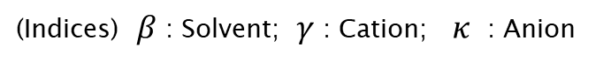
Partition Function Formulation
(Subscripts) $s$ : Solvent; $p$ : Polymer; $e$ : Charged
(Indices) $β$ : Solvent; $γ$ : Cation; $κ$ : Anion
Elastic entropy following Gaussian statistics
Particle Operators
Flory-Huggins short-range interactions
Electrostatic correlations
Local incompressibility
Coulomb Operator
Semicanonical Ensemble

Slide 8
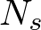

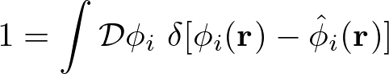
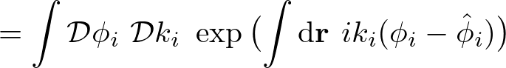
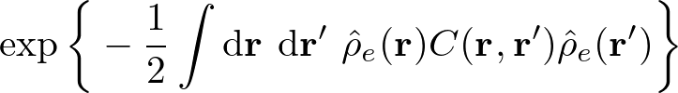
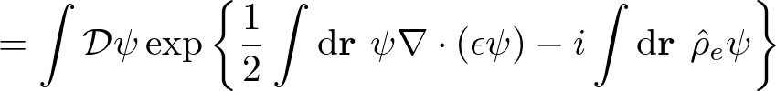

Partition Function Simplification
Particle Operators
Particle-to-Field Transformation
111
Hubbard-Stratonovich Transformation
111
Coulomb Operator
Saddle-point approximation

Slide 9














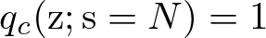
Free Energy and SCF Equations
Free Energy (ensemble average across surface)
Functional Minimization
Polymer Density:
Polymer-controlling Field:
Solvent Density:
Solvent-controlling Field:
Incompressibility:
Monomer Probability:
Electrostatic Potential:

Slide 10
Outline
Systematic Study (VdW Attraction vs. Electrostatic Repulsion)
s
s
s
+
s
+
s
+
+
+
+
+
s
s
+
+
s
Hydrophobicity
(VdW attraction)
s
s
+
s
s
Attractive
Repulsive
Polymer charge fraction
(Electrostatic repulsion)

Slide 11








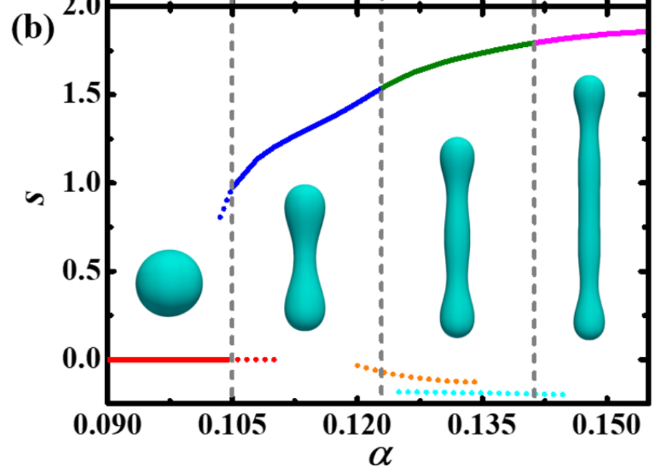



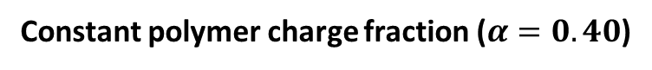
Multi-layered conformations arise at high relative repulsion
System:
Constant polymer charge fraction ($α=0.40$)
C = “condensed” layer(s)
Polymer density profiles
(nm)
Similar “multi-layered” structures in dilute polyelectrolyte solutions
Repulsion promotes segregation, while hydrophobicity and elasticity promote condensation
Not predicted before for brushes
2 condensed layers
1 condensed layer
1 condensed layer
Height
3 condensed layers
4 condensed layers + 1 dilute layer
0
0
(Duan and Wang, JCP, 2020)
0
Polymer distribution
Polymer smeared charge
Flory-Huggins parameter
Free energy
2 condensed layers

Slide 12
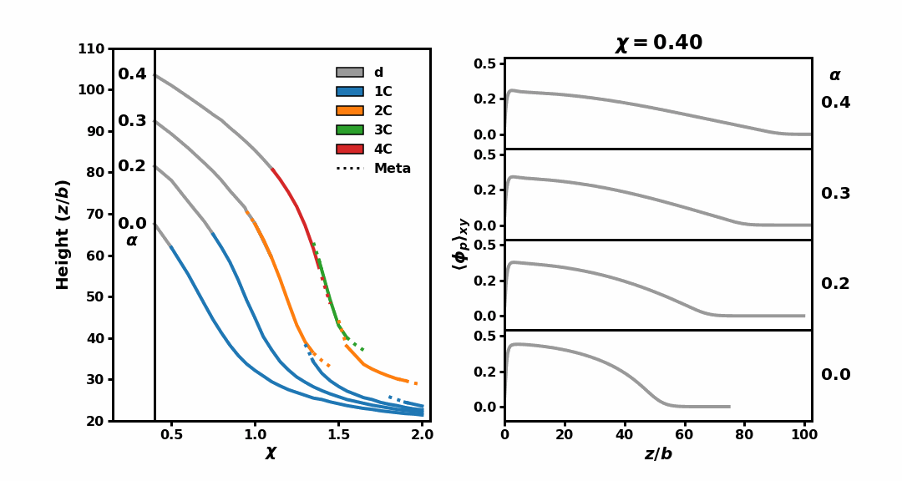
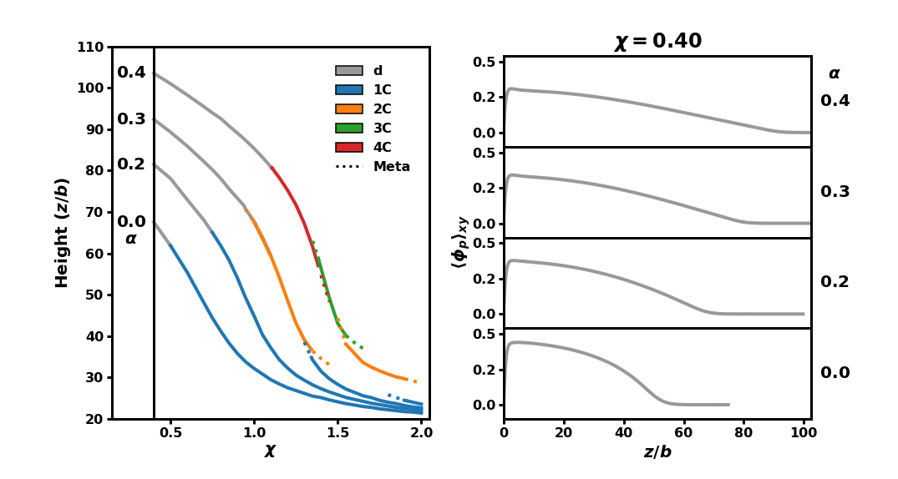
Number of layers tunable with polymer charge fraction
System:
C = “condensed” layer(s)
(nm)
Repulsion
Attraction
Key observations:
Polymer distribution
Polymer smeared charge
Flory-Huggins parameter
High repulsion enriches conformational space
At intermediate repulsion, multiple condensed layers coexist with a dilute layer
High relative attraction eventually causes loss of sensitivity to repulsion

Slide 13



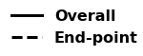

Chain organization within brush is deducible by SCFT
Two candidates with identical averaged density profiles
2 condensed
“Locked-in-layer” minimizes elastic penalty using mushroom conformations
Energetic cost of segregation scales with number of monomers within the “stem” traversing layers
4 condensed + 1 dilute
“Locked-in-layer”
“Pearl-necklace-like”
(Endpoint densities x 30)

Slide 14
Outline
Reflectivity Spectra for Multi-peak conformations
Incident radiation
Measured radiation
Sample
Substrate

Slide 15




Multi-layer conformations generate highly convoluted reflectivity spectra
Reflectivity provides characterization of vertically stacked films (layers)
Specular wave scattering vector
(Schreiber, n.d.)
SCFT-generated Reflectivity Spectra
Polymer profiles are guessed
Fitting such spectra requires a model that can accurately capture coupled interactions, especially elastic
Multi-layered brushes exhibit increasingly sharp interfaces, leading to highly convoluted spectra
(Reinhardt, et. al. Macromolecules, 2013)

Slide 16

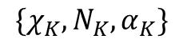
Outline
Application of Theory to Neurofilament-Heavy (NFH) Protein Brush
(Srinivasan, 2014)
“Heavy”
(Yuan, 2012)
“… AQGEEEEEAEEGGEEAATTSPPA …”
Block K
Coarse-grained mapping
$$\{χ_{K},N_{K}, α_{K}\}$$
…
Block 2
Block 1

Slide 17
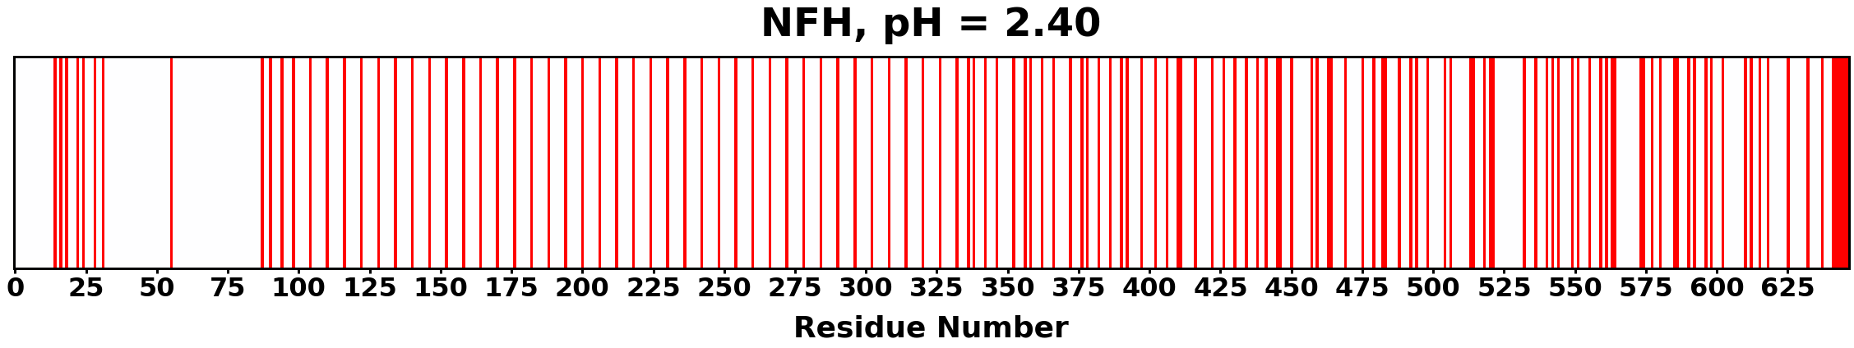
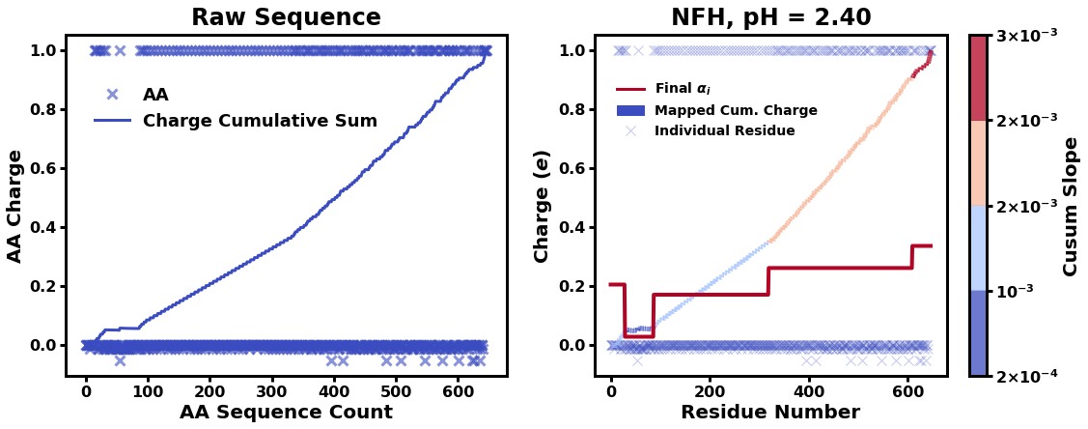
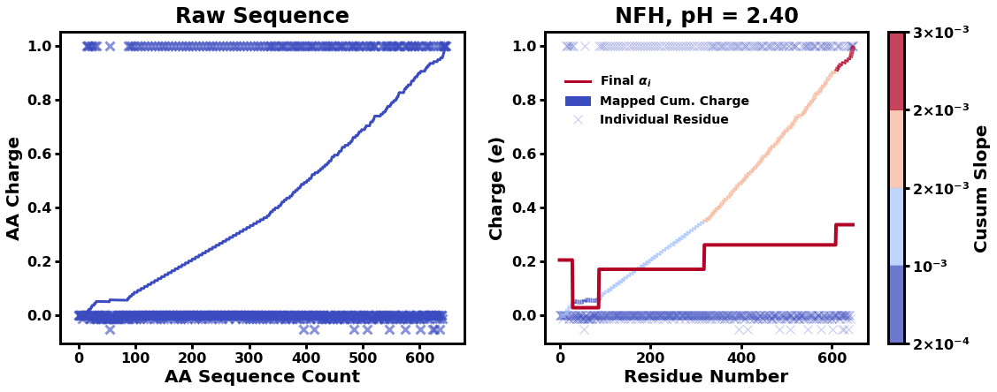
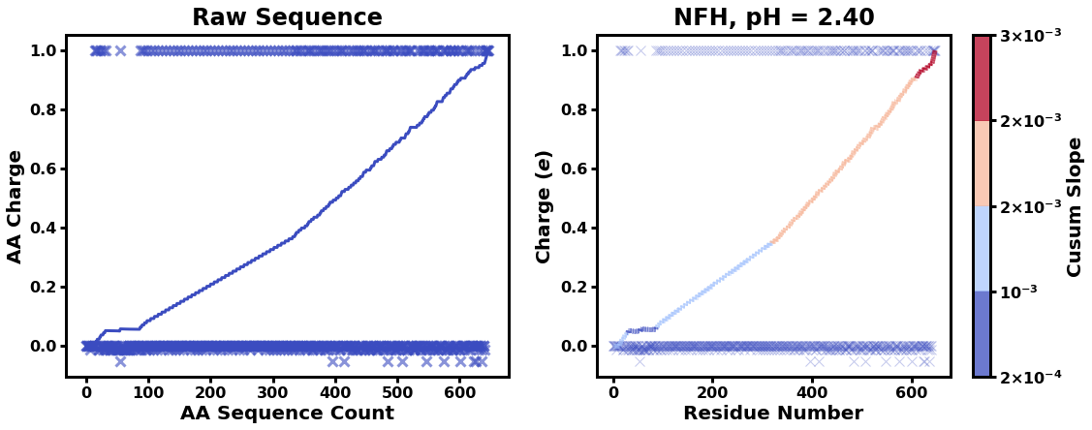

Cusum-generated bins effectively coarse-grain NFH charge distribution
“… AQGEEEEEAEEGGEEAATTSPPA …”
Cusum
Cusum slope
Coarse-grained charge distribution

Slide 18
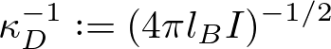
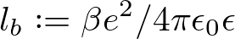

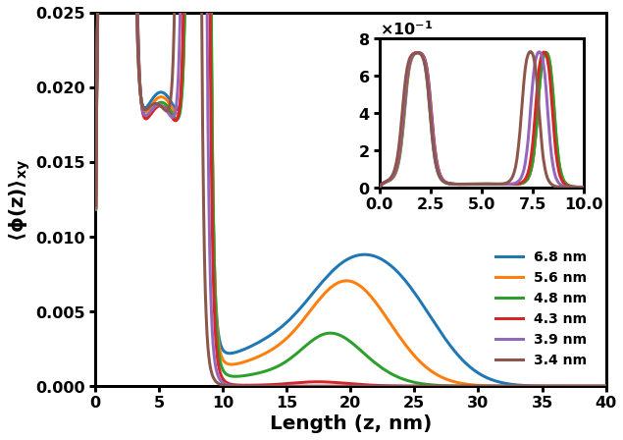
Theoretical prediction matches experimental results
Comparison with Experimental Results
What changes are occurring within NFH during 3x decrease?
Dramatic collapse
2Cd
2C
“Cooperative collapse”
1C
Sensitivity of brush is dependent on internal chain organization and cooperative collapse.
This interactions is unique to conformations with dilute layers.
Locked-in-layer model

Slide 19

Summary
We have derived an SCFT considering the coupling of polymer elasticity, Flory-Huggins interactions, electrostatics, and local incompressibility. Using this theory, we have concluded the following:
Multi-layered conformations are caused by the balance of
Electrostatics (repulsion)
Hydrophobicity and elasticity (attraction)
SCFT-generated reflectivity spectra should facilitate experimental evidence of multi-peaked conformations
Chains stay within one layer to minimize overall elastic penalty
Subsequent layers are “grafted upon” previous layers
The dramatic collapse of the NFH brush is due to cooperative effects specific to a dilute layer coexisting with condensed layers

Slide 20
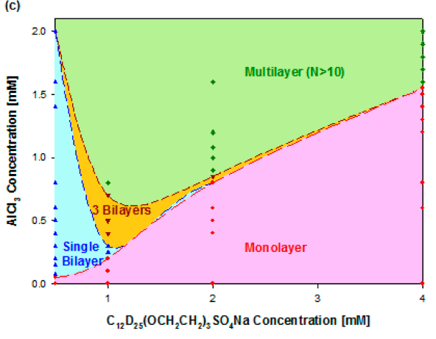
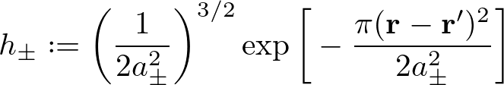
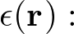
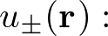
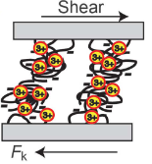
Future Work — Considering electrostatic fluctuations through the ion self energy
Multivalent ions facilitate multi-layer brushes at low ionic concentrations and bridging effects between opposing brushes
No current theories can capture either phenomena
Ion fluctuations are needed to consider inhomogeneous dielectric media and specific ion effects
AlCl₃ Concentration [mM]
Ion radius
Ion distribution:
Permittivity
Ion self energy
The “modified PB equation” contains ion self energy, which describes the energy of charge fluctuations
SLE₃S Concentration [mM]
1 mM Ba²⁺
1 mM Ca²⁺
0.1 mM Ca²⁺
Next project will study the attractive force between interacting brushes in multivalent solutions
Equations need to include ion fluctuations
Computational efficiency for solving Green’s function
0.01 mM Ca²⁺
6 mM Na⁺
(Yu et al., Science, 2018; Xu et al., Langmuir, 2013; Wang Phys Rev E, 2010)

Slide 21
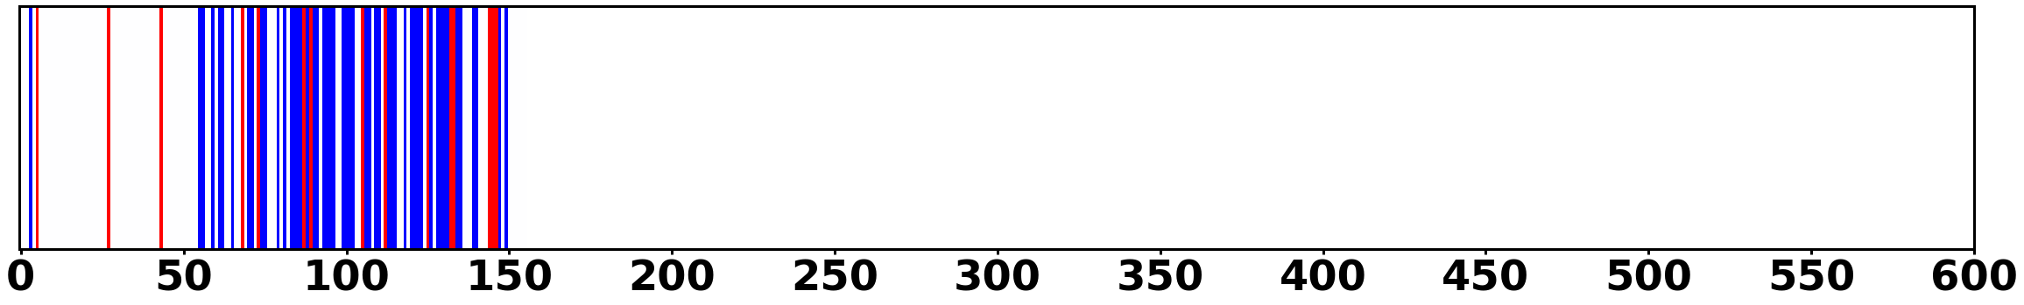
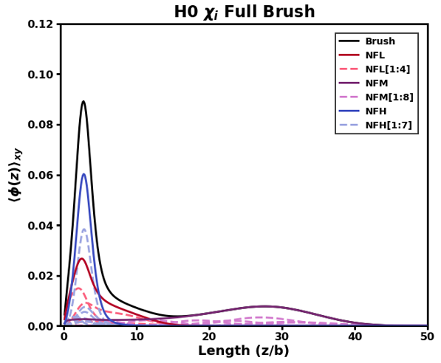
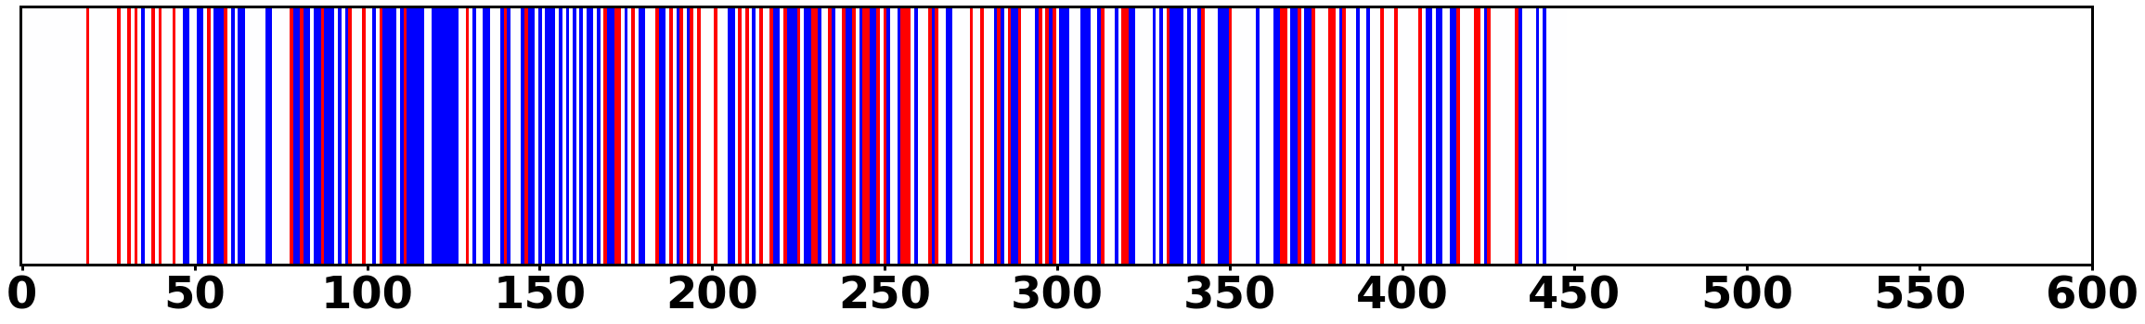
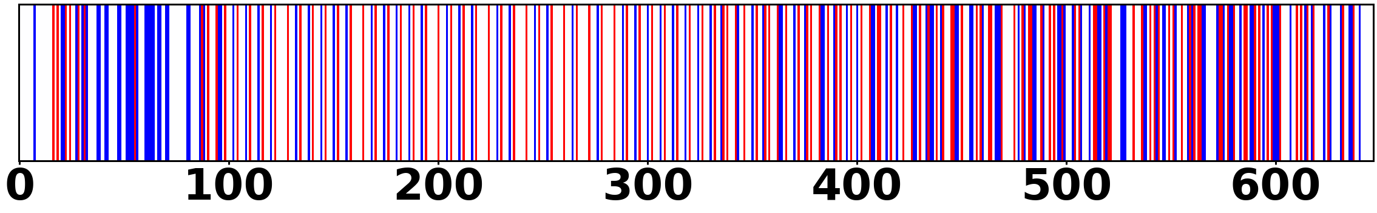
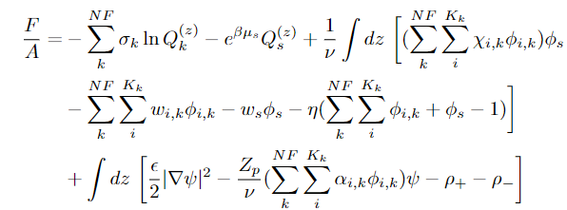
Future Work — Effect of mixture compositions and sidearm sequences on neurofilaments
Neurofilaments are mainly composed of 3 chain types (L/M/H), whose composition is strictly regulated during development
Sidearms have evolved into considerably different sequences
pH = 7.44
Black: Overall
Red: L
Purple: M
Blue: H
Light (L)
Medium (M)
Polymer Density
Heavy (H)
Length [nm]
Theory is modified to consider mixtures of L/M/H
As for NFH results, SCFT provides experimentally inaccessible polymer profiles and structure
Future contributions include ternary phase diagrams and the role of sequences on overall neurofilament structure and response

Slide 22






Acknowledgements
Wang Group
Prof. Rui Wang
Dr. Chao Fang
Luofu Liu
Nikhil Agrawal
Dr. Chao Duan

Slide 23
Summary
We have derived an SCFT considering the coupling of polymer elasticity, Flory-Huggins interactions, electrostatics, and local incompressibility. Using this theory, we have concluded the following:
Multi-layered conformations are caused by the balance of
Electrostatics (repulsion)
Hydrophobicity and elasticity (attraction)
SCFT-generated reflectivity spectra should facilitate experimental evidence of multi-peaked conformations
Chains stay within one layer to minimize overall elastic penalty
Subsequent layers are “grafted upon” previous layers
The dramatic collapse of the NFH brush is due to cooperative effects specific to a dilute layer coexisting with condensed layers

Slide 24
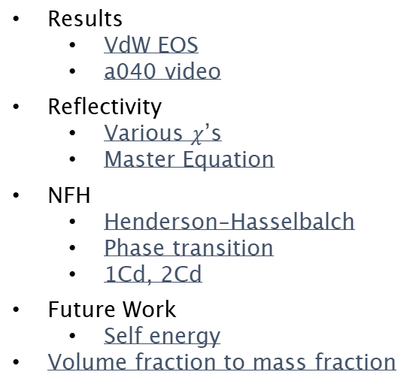
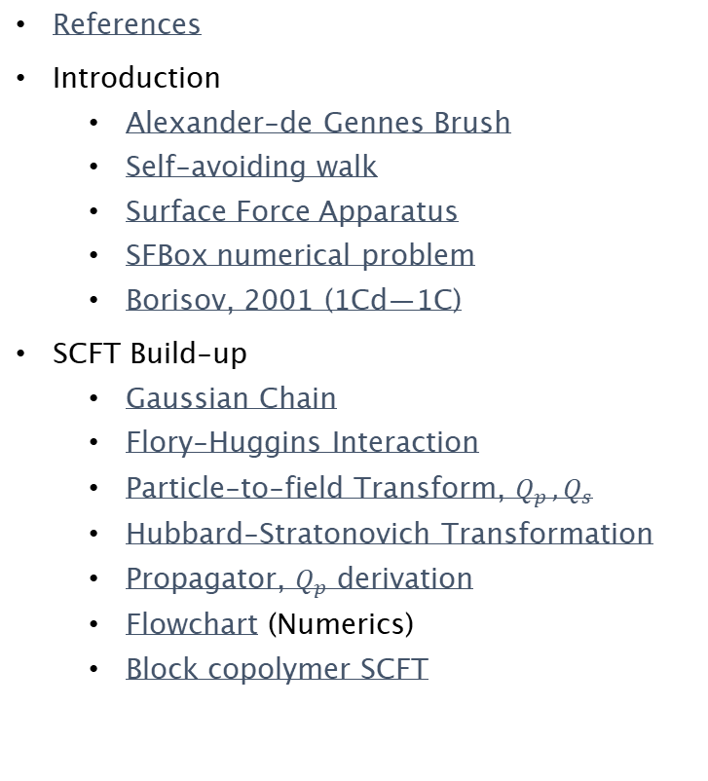
SI: Table of Contents
Presentation Outlines:
Title
Model and Theory
Systematic Study
Reflectivity
NFH
Summary
Future Work
References
Introduction
Alexander-de Gennes Brush
Self-avoiding walk
Surface Force Apparatus
SFBox numerical problem
Borisov, 2001 (1Cd—1C)
SCFT Build-up
Gaussian Chain
Flory-Huggins Interaction
Particle-to-field Transform, $Q_{p }, Q_{s}$
Hubbard-Stratonovich Transformation
Propagator, $Q_{p}$ derivation
Flowchart (Numerics)
Block copolymer SCFT
Results
VdW EOS
a040 video
Reflectivity
Various $χ$’s
Master Equation
NFH
Henderson-Hasselbalch
Phase transition
1Cd, 2Cd
Future Work
Self energy
Volume fraction to mass fraction

Slide 25
References
Abnormal NF image: Yuan, A., Rao, M. V., Veeranna, & Nixon, R. A. (2012). Neurofilaments at a glance. Journal of Cell Science, 125(14), 3257–3263. https://doi.org/10.1242/jcs.104729
Height Profile Figure: Srinivasan, N., Bhagawati, M., Ananthanarayanan, B., & Kumar, S. (2014). Stimuli-sensitive intrinsically disordered protein brushes. Nature Communications, 5(1), 5145. https://doi.org/10.1038/ncomms6145
Alexander-de Gennes Brush: Rubinstein, M., & Colby, R. H. (2003). Polymer Physics, Oxford University Press. New York.
Lubricity Figure: Yu, J., Jackson, N. E., Xu, X., Morgenstern, Y., Kaufman, Y., Ruths, M., de Pablo, J. J., & Tirrell, M. (2018). Multivalent counterions diminish the lubricity of polyelectrolyte brushes. Science, 360(6396), 1434–1438. https://doi.org/10.1126/science.aar5877
XR Multilayer Figure: Xu, H., Penfold, J., Thomas, R. K., Petkov, J. T., Tucker, I., & Webster, J. P. R. (2013). The Formation of Surface Multilayers at the Air–Water Interface from Sodium Polyethylene Glycol Monoalkyl Ether Sulfate/AlCl ₃ Solutions: The Role of the Size of the Polyethylene Oxide Group. Langmuir, 29(37), 11656–11666. https://doi.org/10.1021/la4030348
Anti-Biofouling Figure: Chen, W.-L., Cordero, R., Tran, H., & Ober, C. K. (2017). 50th Anniversary Perspective: Polymer Brushes: Novel Surfaces for Future Materials. Macromolecules, 50(11), 4089–4113. https://doi.org/10.1021/acs.macromol.7b00450
XR Layout Figure: Schreiber, F., & Gerlach, A. (n.d.). X-Ray and Neutron Reflectivity. Department of Chemistry - University of Oxford. www.physchem.ox.ac.uk/~fs
XR Spectra Figure: Reinhardt, M., Dzubiella, J., Trapp, M., Gutfreund, P., Kreuzer, M., Gröschel, A. H., Müller, A. H. E., Ballauff, M., & Steitz, R. (2013). Fine-Tuning the Structure of Stimuli-Responsive Polymer Films by Hydrostatic Pressure and Temperature. Macromolecules, 46(16), 6541–6547. https://doi.org/10.1021/ma400962p

Slide 26




Alexander-de Gennes Brush
Monomers in correlation blobs (self-avoiding walk)
Height = Correlation length x No. Correlation blobs
“Correlation length”
Rubinstein, M., & Colby, R. H. (2003). Chapter 5.3

Slide 27
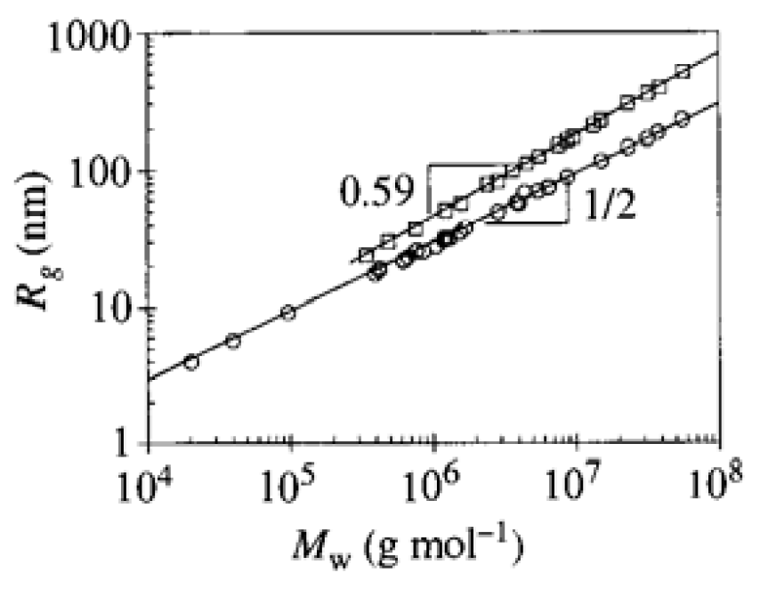
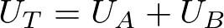
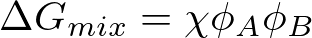

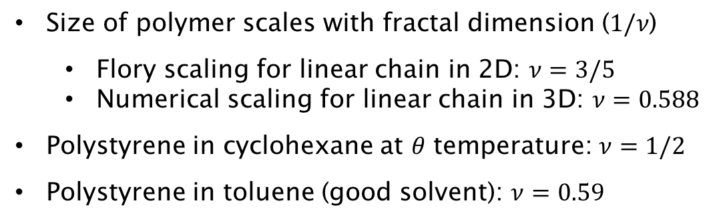
Self-avoiding walk & Flory-Huggins Interactions
Size of polymer scales with fractal dimension ($1/ν$)
Flory scaling for linear chain in 2D: $ν=3/5$
Numerical scaling for linear chain in 3D: $ν=0.588$
Polystyrene in cyclohexane at $θ$ temperature: $ν=1/2$
Polystyrene in toluene (good solvent): $ν=0.59$
Rubinstein, M., & Colby, R. H. (2003). Chapter 3.1.2

Slide 28
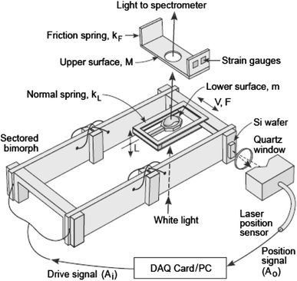
Surface Force Apparatus (SFA)
Distance (D) is calculated using a spectrometer, which generates Fringes of Equal Chromatic Order (FECO)
Mirrors allow only wavelengths that form standing waves between to constructively interfere
Distance is measured by relating FECO wavelength to that from mica in contact
Lowrey, D. D., Tasaka, K., Kindt, J. H., Banquy, X., Belman, N., Min, Y., Pesika, N. S., Mordukhovich, G., & Israelachvili, J. N. (2011). High-Speed Friction Measurements Using a Modified Surface Forces Apparatus. Tribology Letters, 42(1), 117–127. https://doi.org/10.1007/s11249-011-9746-1

Slide 29

SFBox Lattice Artifacts
Pryamitsyn, V. A., Leermakers, F. A. M., Fleer, G. J., & Zhulina, E. B. (1996). Macromolecules, 29(25), 8260–8270.

Slide 30


Borisov previous theory
Klushin, Birshtein, Amoskov. (2001). Macromolecules, 34.

Slide 31




Block copolymer Free Energy, SCF Eqns
Variational Free Energy
After statistical average over grafting surface (x-y plane)
Functional Minimization
SCF Equations

Slide 32


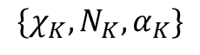
Block copolymer PDEs
Mean-field Poisson-Boltzmann Equation
Modified Diffusion Equation
Block K
$$\{χ_{K},N_{K}, α_{K}\}$$
Block 2
Block 1

Slide 33











Gaussian Chain
Probability of R with N
Bond vector distribution
Local Fluctuation
Generalize to whole chain with free internal segments
Large N, kb << 1
Configurational integral with free ends

Slide 34



Particle-to-Field Transform

Slide 35
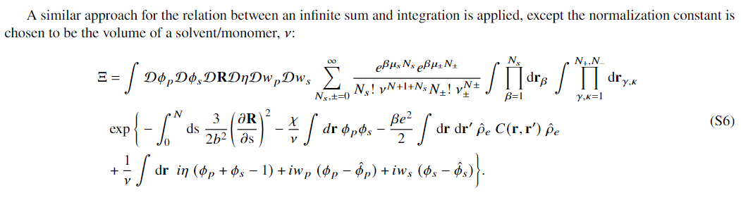


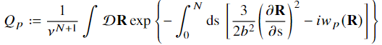
Particle-to-Field Transform (2) & Qs, Qp
Cancels out

Slide 36







Hubbard-Stratonovich Transformation
Constant, ignored
Electrolyte GCE

Slide 37





Propagator notation
“Chain energy” between s1 and s2 in curve R
“Propagator” from Boltzmann factor and known endpoints of chain end (0) and contour length s
Forward propagator

Slide 38





SCFT Build-up — Flowchart
PDE Solve (for iteration k)
Propagate (using PDE solutions)
Check (for self-consistency)
Update (if not satisfied)
Anderson Mixing
Simple Mixing
Notation slightly incorrect but changed for clarity. w^{k} = f(w^{k+1/2}, w^{k-1}), where w^{k+1/2} is from SCFT calculations (\phi remains ^{k})

Slide 39



VdW EOS
Intermolecular attraction
Repulsion (hard-core)

Slide 40


Varying VdW ($χ$) at const. Electrostatic ($α=0.40$)
System:
Polymer distribution
Polymer smeared charge
Flory-Huggins parameter
Free energy

Slide 41


Reflectivity — Different $χ$’s

Slide 42










Reflectivity Master Equation Derivation
“missing” length dimension
C =i ; from integration over all area elements at z
Continuous density profile (Reimann sum analogue)
2
Phase factor for interference:
Scattered amplitude
Integration by parts
Incident amplitude
Wavelength
Scattering density proflile
Qz notation, non-normalized density, Fresnel reflectivity
Incident angle
Scattering vector
Russel, T.P., Materials Science Reports, 1990

Slide 43





Henderson-Hasselbalch
AA | pKa | pKb
D (Aspartic Acid) | 3.65
E (Glutamic Acid) | 4.25
K (Lysine) |  | 10.53
R (Arginine) |  | 12.48
H (Histidine) |  | 6.00

Slide 44

NFH Phase Transition

Slide 45


NFH 1Cd, 2Cd

Slide 46




Self energy
Ion radius
After Hubbard-Stratonovich
Fluctuating field
Average (saddle-point) field
Ion charge distribution:
Ion self energy
Reference action:
Gibbs-Feynman-Bogoliubov Inequality:
ref
Grand Free Energy:
Minimization wrt

Slide 47














Volume fraction to mass distribution
Density of polymer non-trivial, but could use some scaling arguments (like Alexander-de Gennes brush)

